Slide 1
ECON M 524- FINANCIAL ECONOMETRICS
FINAL PROJECT
Forecasting yen vs dollar using ARIMA model
by Sricharan Cheeti
Data Science Graduate Student
Indiana University Bloomington

Slide 2
Research Question
Forecasting the future yen vs dollar values using different ARIMA models
Used Multiple ARIMA models to check which combination works best

Slide 3
Data Description
It contains 5 columns and 784 rows in total.
Date-from 1/1/19 to 1/1/22
Open-How much is the yen value opened when the market opened.
High-The highest the yen value reached during the market hours on that day.
Low-The least the yen value reached on that day.
Close-The yen value when the market closed.

Slide 4
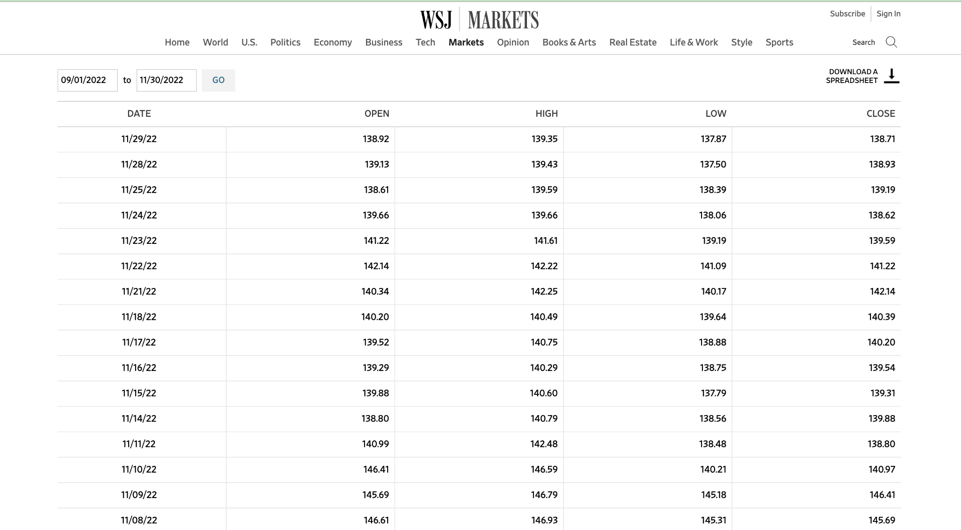
Data Source
https://www.wsj.com/market-data/quotes/fx/USDJPY/historical-prices

Slide 5
Research Method
ARIMA(p,q,d)
Auto Regressive Integrated Moving Average
An ARIMA model is characterized by 3 terms: p, d, q where,
-> p is the order of the AR term
->q is the order of the MA term
->d is the number of differencing required to make the time series stationary

Slide 6
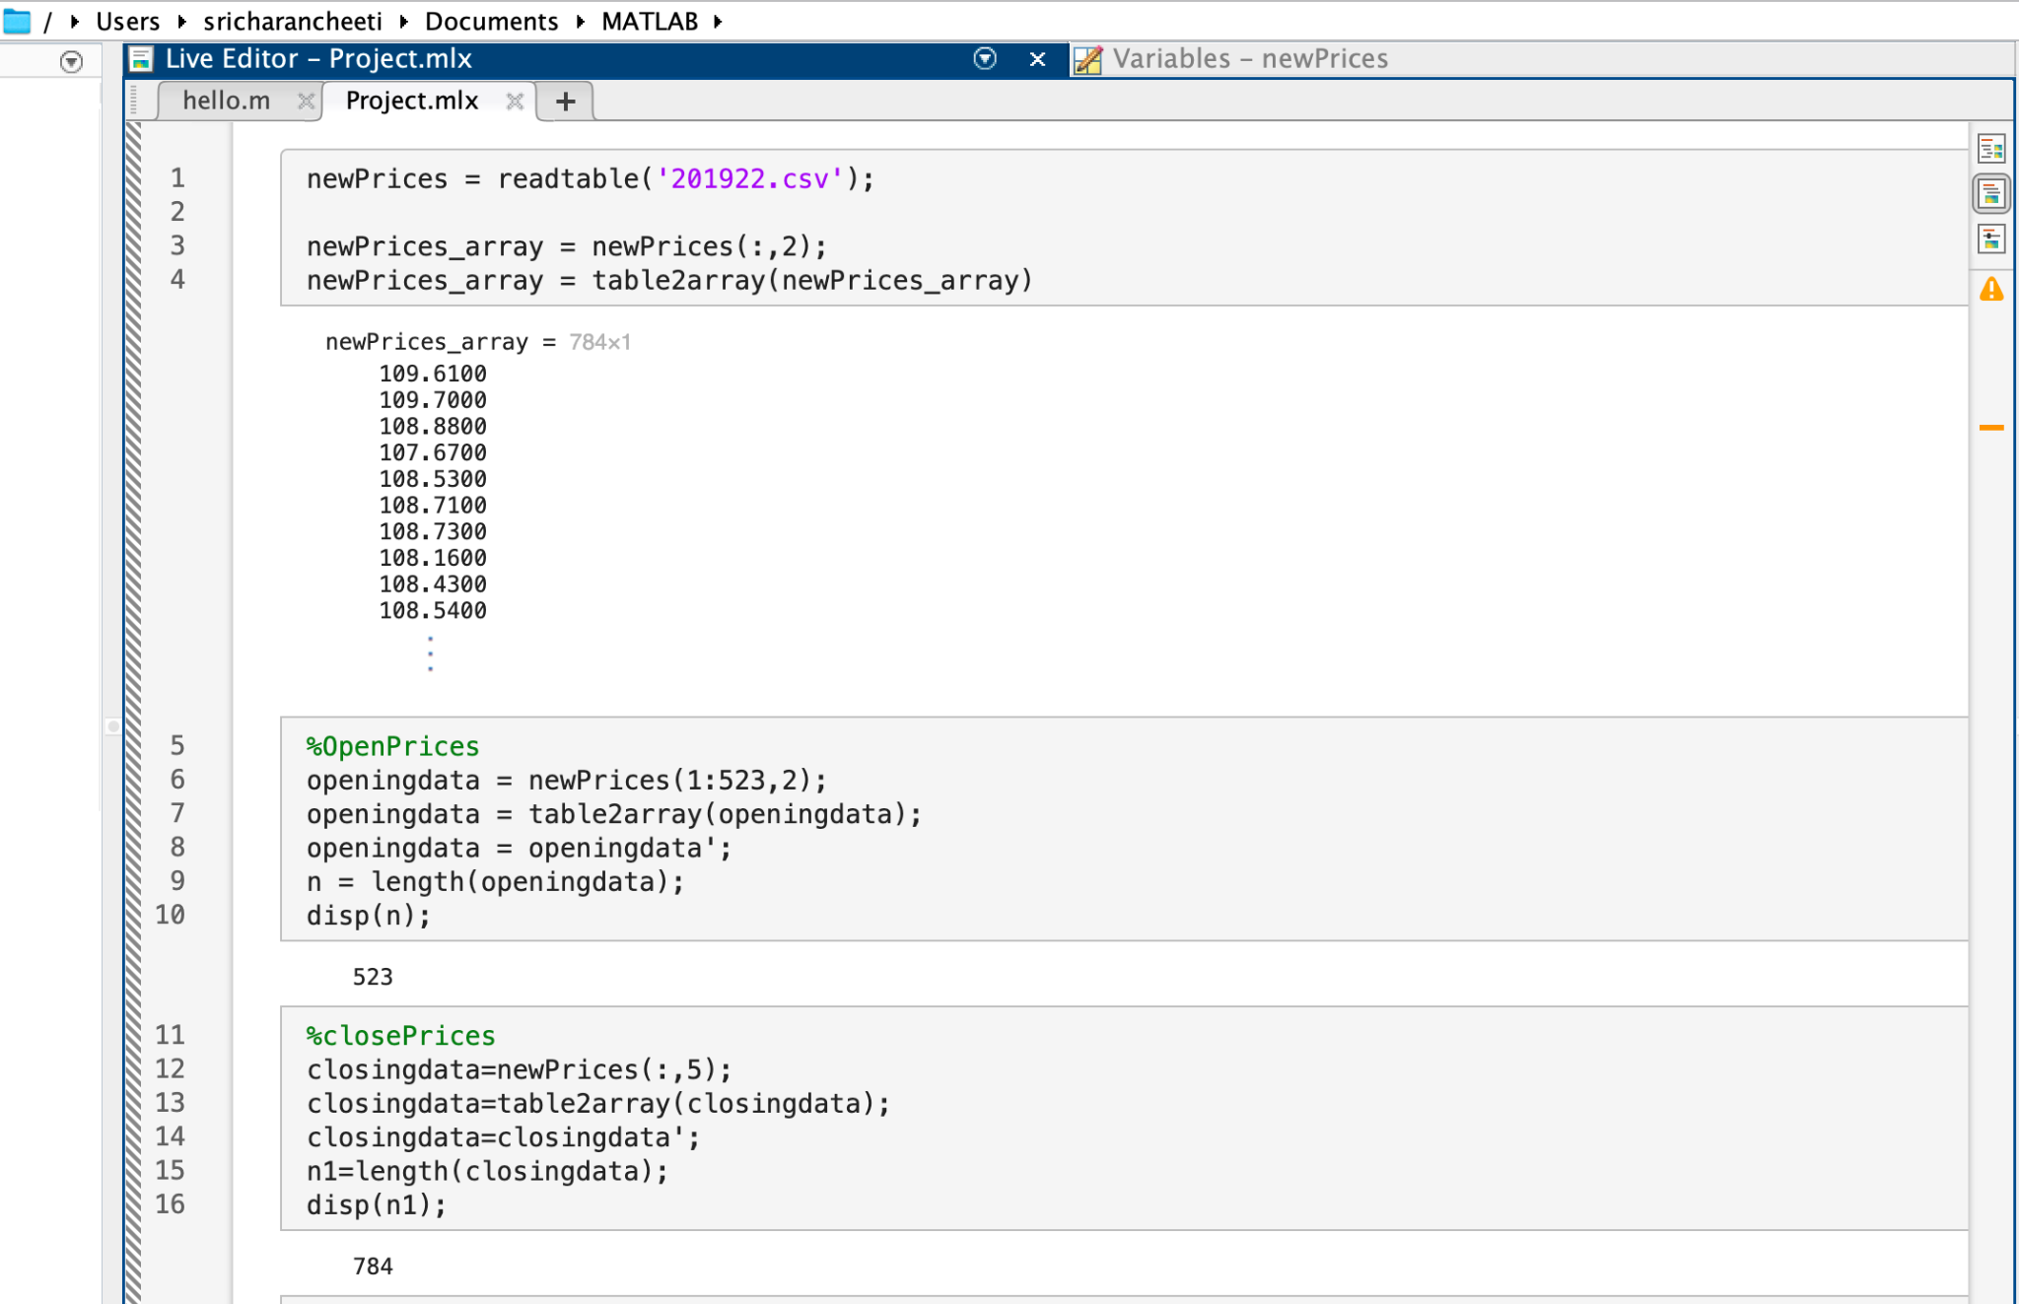
Step-1

Slide 7
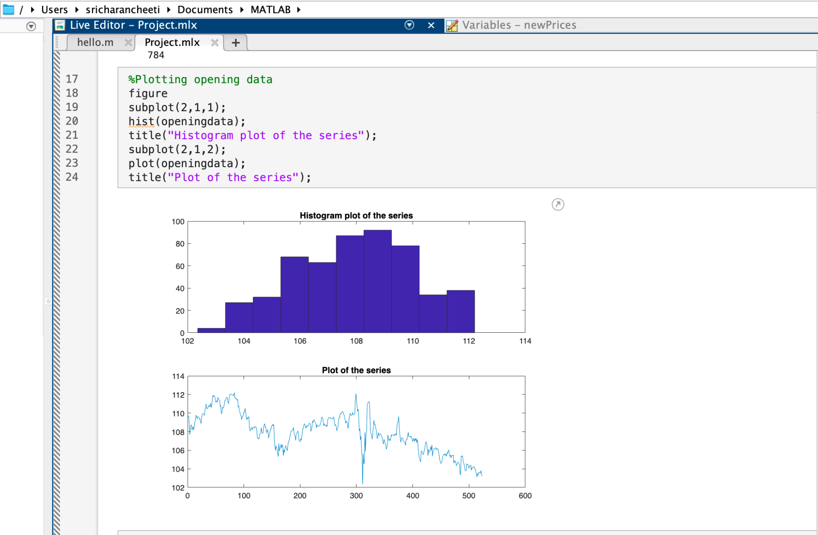

Slide 8
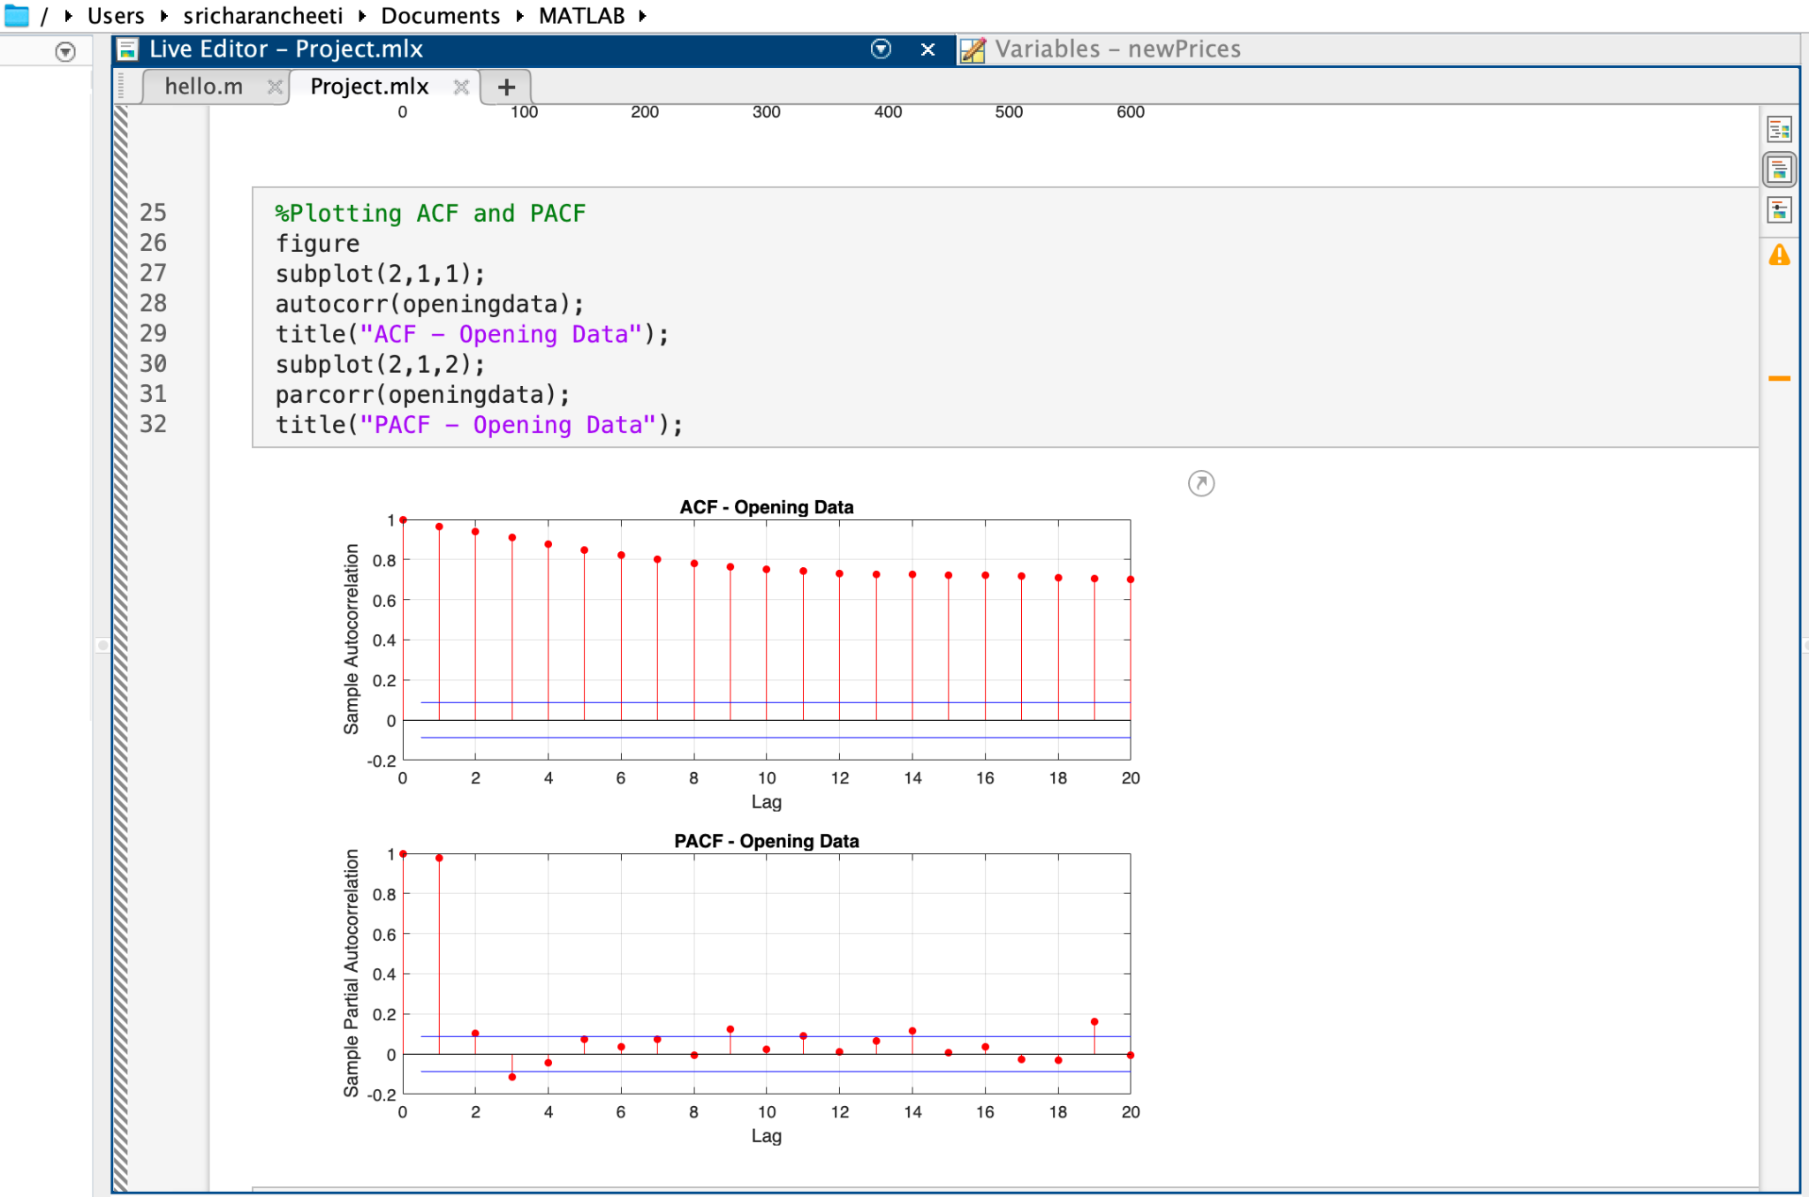
STEP 2

Slide 9
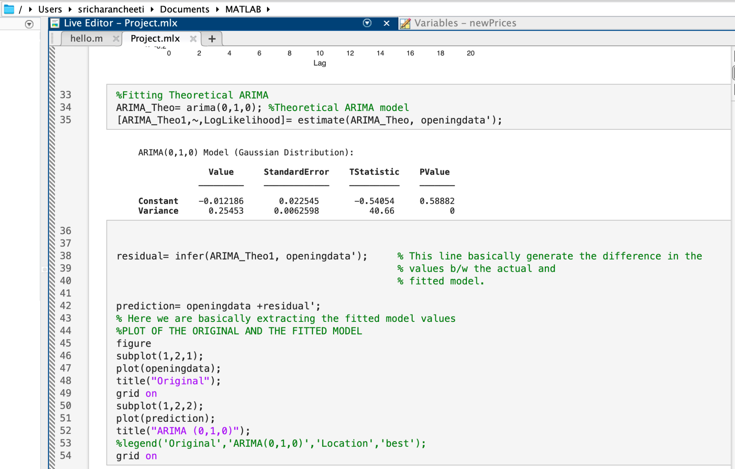
STEP 3- Fitted a theoretical ARIMA

Slide 10
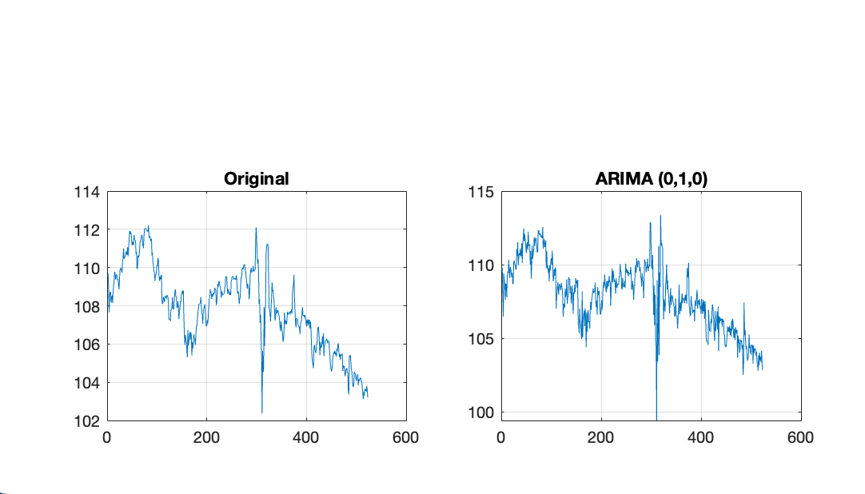

Slide 11
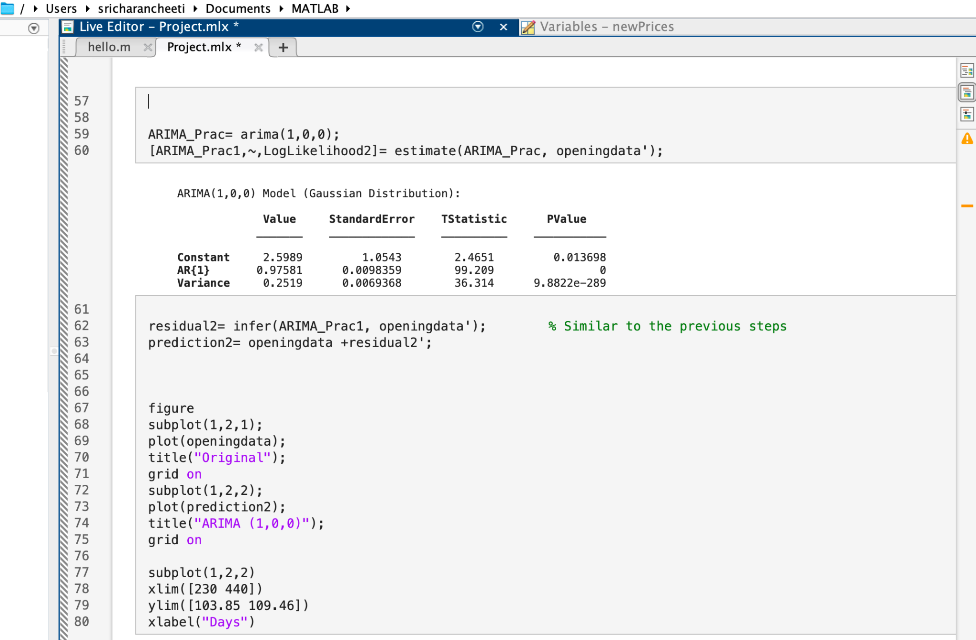
STEP 4- Try to find a better fitting ARIMA model

Slide 12
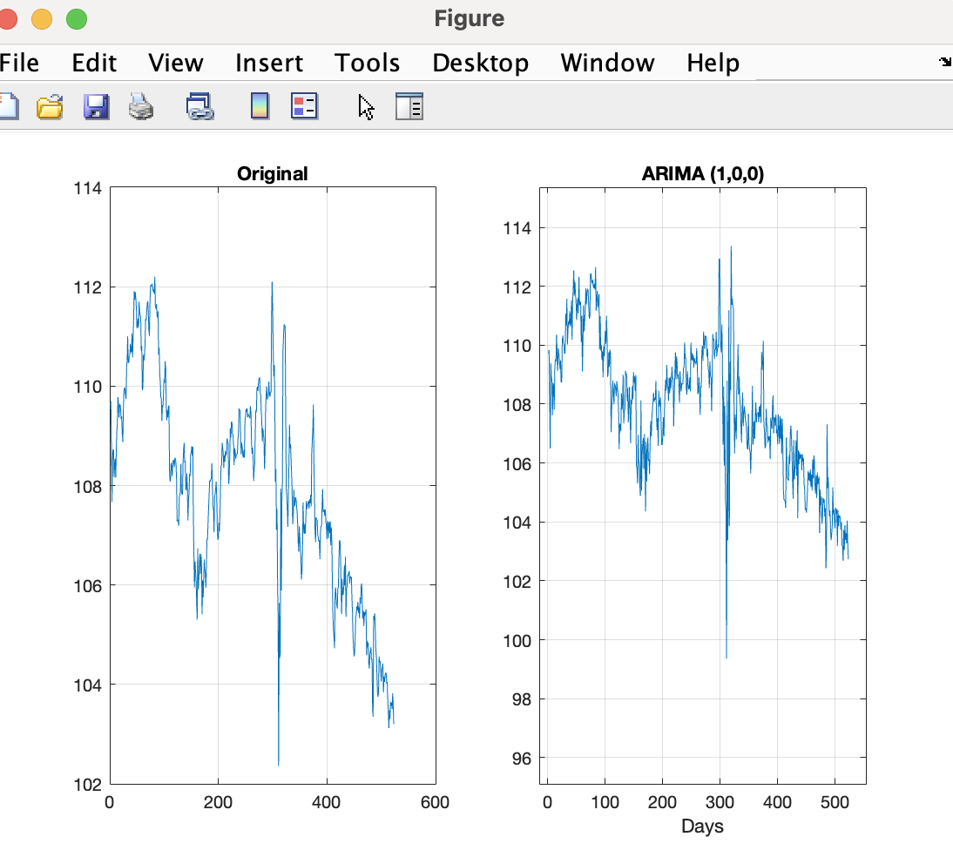

Slide 13
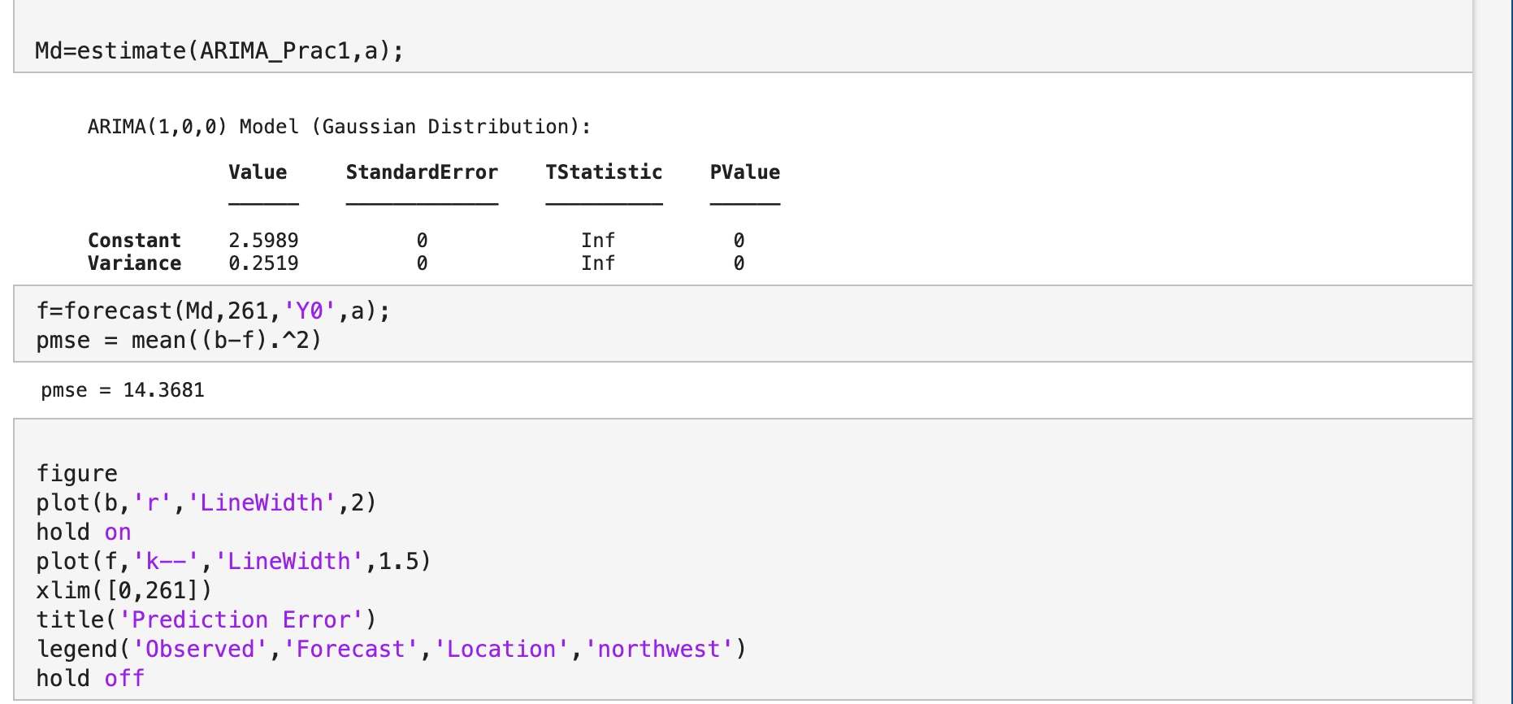
STEP 5-Forecasting using the ARIMA(1,0,0)

Slide 14
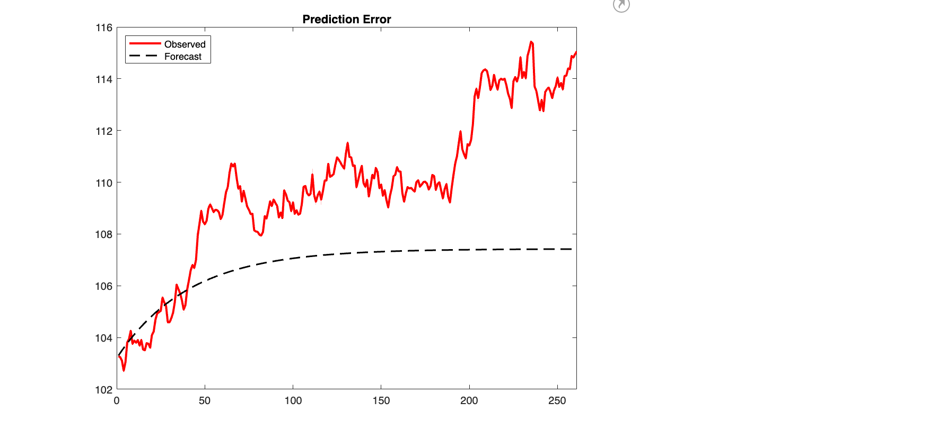
Original Yen value vs Forecasted Yen value

Slide 15
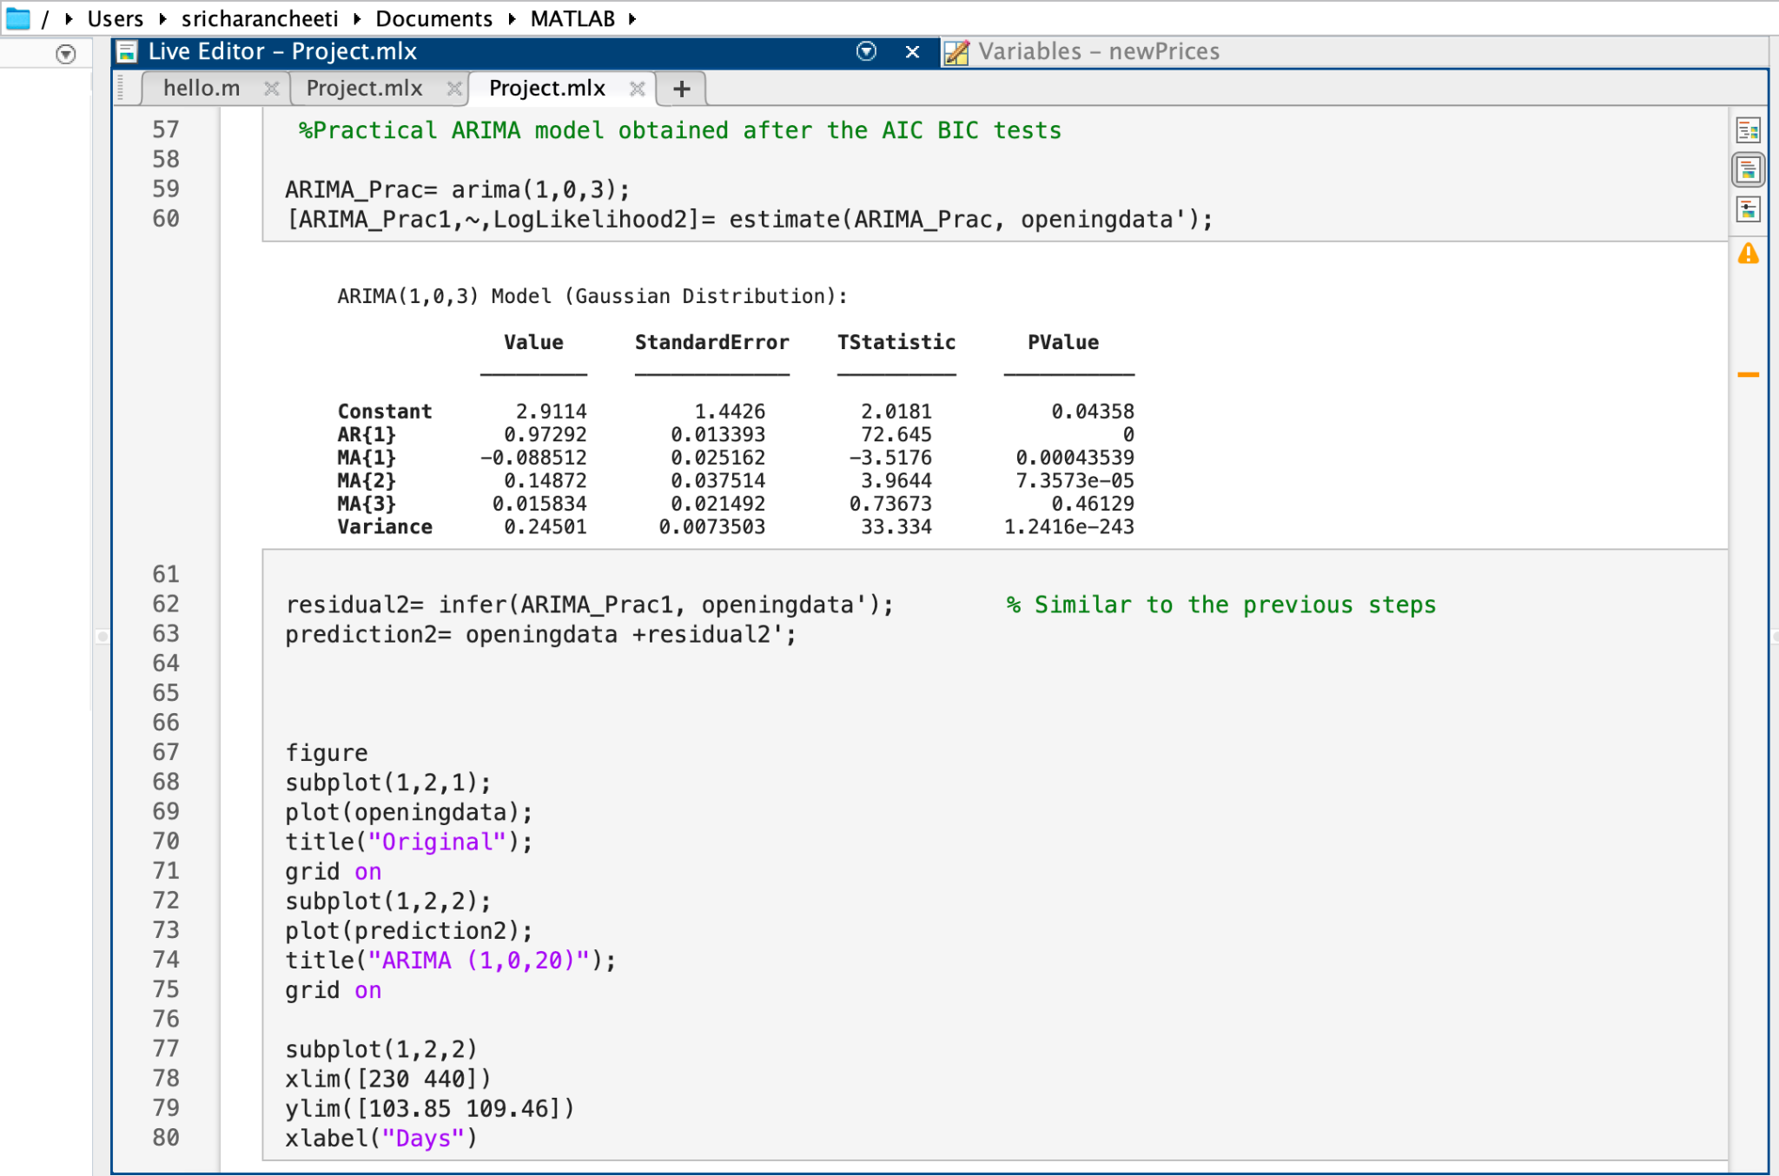
STEP 6-The model with least PMSE

Slide 16
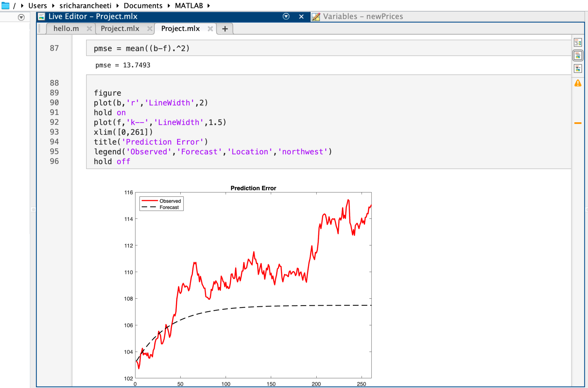

Slide 17
Conclusion
The ARIMA model arima(1,0,3) has p value less than 0.005,therefore it is statistically significant.
The Prediction Mean Square Error(PMSE) is still higher.
We could use AIC and BIC selection criteria for finding a better fit ARIMA model.
When it comes to investing real money, I would not base my decisions solely on the results of these models. Before using them, I would want to improve them by training the models and making them more statistically significant. If I did that, I would use them as one of the factors I consider, but would want to look at other factors as well before making any investment decisions.

Slide 18
THANK YOU!

